Slide 1
On-Line Auction Proposal
Washington State Council FFI to manage a web based auction designed to replace our charitable auctions held at the Volunteer Appreciation Dinner. This proposal is required to avoid depleting our funds if we choose to some make some charitable contributions.
  WSCFFI donated or had auction $ flow through the council of :
  $6,892.52

Slide 2
On-Line Auction-- What this is NOT
This is NOT intended to replace out Banquet Auction
This is NOT a raffle nor will a raffle be entertained. Washington State Law does NOT allow web based raffles regardless of where the Hosting site is located
This is NOT going to cost WSCFFI anything (net to the charities)
This is NOT going to take more than 8 hours a month (Sam’s Est)
This is NOT being defined as an on going event (2020 discussion)

Slide 3
On-Line Auction-- What this IS
This auction IS to replace our charitable auctions
held at the volunteer appreciation dinner
This IS utilizes Social Media to access NEW potential bidders
This IS being managed by a very small group (Carol, Steve, Sam)
This IS supporting 3 Charities: (discussion point go to 5?)
  Project Healing Waters
  Casting for Recovery
  OPFI
  Northwest Fishing Academy
  TBD
Notes:
.

Slide 4
On-Line Auction-- Key Points
Donation to the various non profit groups will be net of all expenses
Funds raised will be evenly divided between groups
If a non profit supplies a donation item, we will run the auction BUT the money raised would flow to them through the WSCFFI
This auction event will start in Sept 2019 and end approximately 2 weeks prior to our Annual Banquet
Depending on success of this auction and availability of resources we MAY decide to utilizing this as a fund raiser beyond 2020

Slide 5
On-Line Auction-- Key Points
Bidding Owl will be Online Host for our auction
  There is a 5% cost associated with Online
  Money to be transferred directly into WSCFFI Account
    If bidding for an item ends at $200,
    Bidding Owl will keep $10,
    money will be directly to our account through ACH or to a debit
    Shipping paid by the winning bid
Prior to each Auction we will use Social Media to raise awareness
  May Target specific SM media sites on unique items
Tentative plan is to run “2” auctions a month initially after the 1st couple of months we may re-evaluate our process and shift auction format

Slide 6
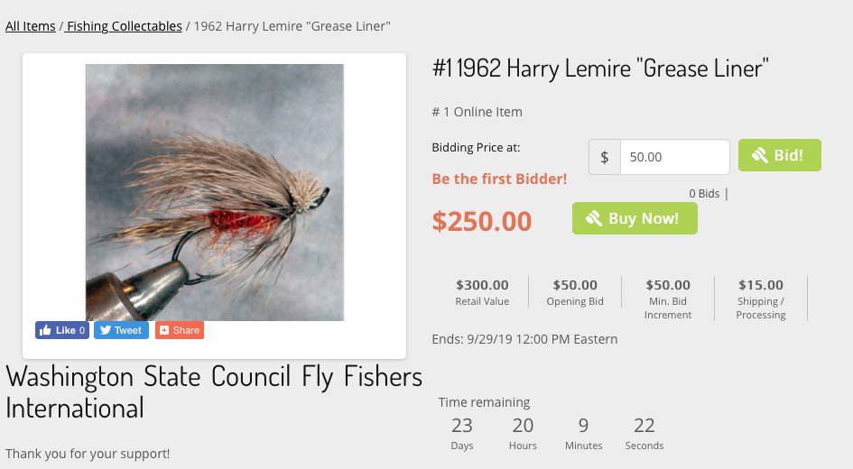
On-Line Auction– BiddingOwl example

Slide 7
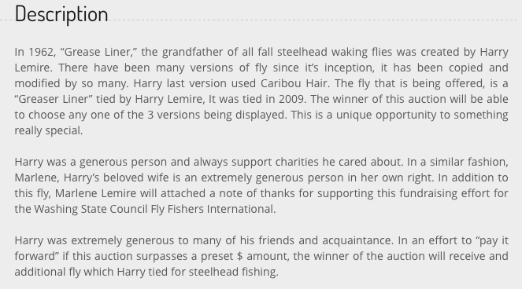
On-Line Auction– BiddingOwl example

Slide 8
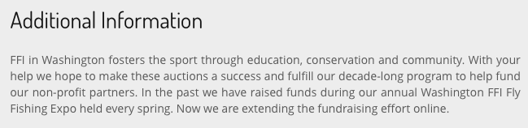
On-Line Auction– BiddingOwl example

Slide 9
On-Line Auction– Key Points
1st Auction is tentatively planned for Sept 15-30
Looking for unique donations from WSCFFI members initially
  Example: Harry Lemire Greased Liner Fly
  May target specific suppliers if we have issues getting items
Steering team (Carol, Steve, Sam) will judge if certain donations are better suited for our Annual Banquet

Slide 10
On-Line Auction
Can we proceed?

