Slide 1

Fly Fishers International
Washington State Council Treasurer's Report
For Fiscal Year Ending 6/30/2019

Slide 2
WSC FFI
Financial Highlights and Key Take Aways
For the fiscal year ending 6/30/2019, Fair Margin generated by hosting the Fair was $4,220.04. Note: All income generated from the sale of raffle tickets were included in Fair Margin)
For the same period, loss from Non-Fair activities was $(3,634.93). Of this amount, only $1,160.65 (32%) are fixed while remaining Non-Fair expenses of $2,474.28 (68%) are discretionary.
Fair Margin + Non-Fair Expenses = $585.11 Net Profit
As of June 30, 2019 the cash balance was $45,186.73. This compares to a prior year balance of $44,601.62, an increase of $585.11.
During the year, WSC FFI raised or donated $6,892.52 for various non profit organizations.

Slide 3
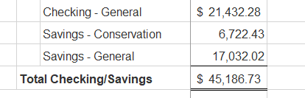
Cash Position
As of June 30, 2019

Slide 4
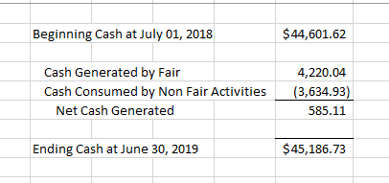
Cash Roll Forward
For Fiscal Year Ending June 30, 2019

Slide 5
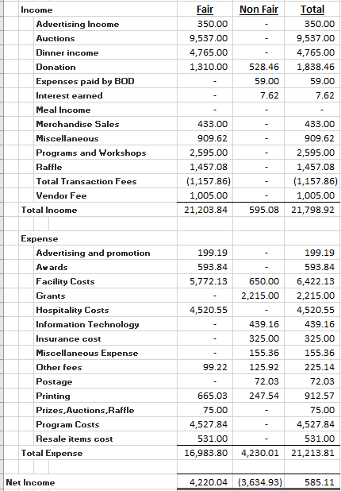
Profit (Loss) Statement
For Fiscal Year Ending June 30, 2019
A
See analysis on Page 13
B
C
See analysis on Page 17
See analysis on Page 10
See analysis on Page 16
D
See analysis on Page 13
E
See analysis on Page 14

Slide 6

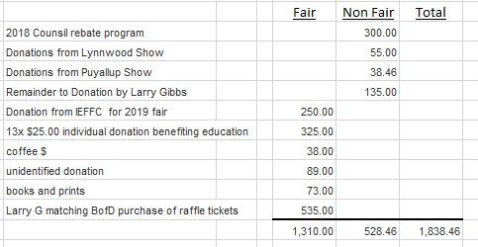
Notes to Profit (Loss) Statement
For Fiscal Year Ending June 30, 2019
A
Auction Income
B
Donation Income

Slide 7


Notes to Profit (Loss) Statement (Continued)
For Fiscal Year Ending June 30, 2019
C
Merchandise Sales Income
D
Facility Cost Expense

Slide 8

Notes to Profit (Loss) Statement (Continued)
For Fiscal Year Ending June 30, 2019
E
Program Cost Expense

Slide 9
Other Financial Highlights

Slide 10
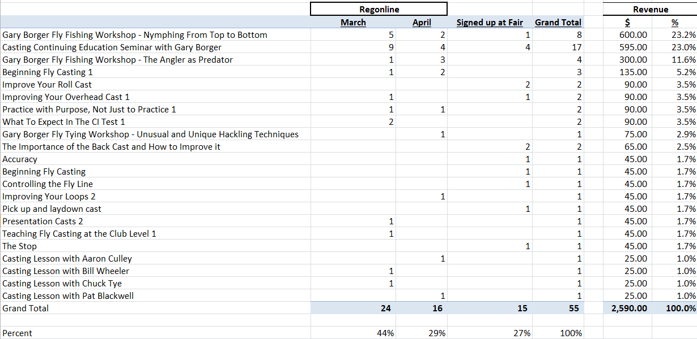
Other Financial Highlights
During the fiscal year, income generated from Programs and Workshops was $2,590.00 from 55 individual participants. Specifically, Borger’s classes generated $1,570 or 61% of total.
Note: Revenue off by $5.00 compared to P&L

Slide 11
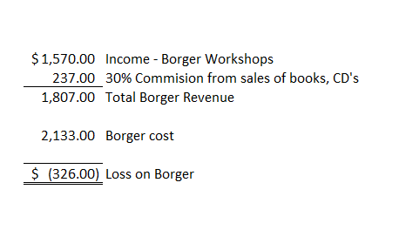
Other Financial Highlights (Continued)
Direct loss related to Gary Borger was $(326.00). However, this does not consider the indirect benefits such as free workshops presented by Gary.

Slide 12
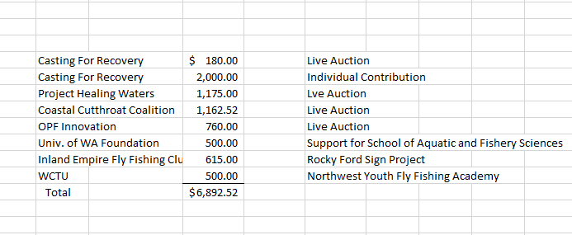
Other Financial Highlights (Continued)
During the fiscal year, WSC FFI raised or donated $6,892.52 for various non profit organizations.

Slide 13
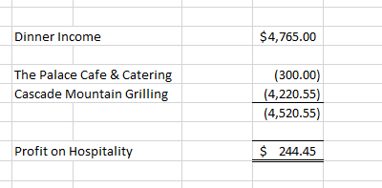
Other Financial Highlights (Continued)
We made a slight profit of $244.45 on Hospitality Activities. Total Dinner Income of $4,765.00 equates to 106 paid individuals at Friday nights dinner (assuming $45.00 per dinner ticket and everyone who purchased a ticket attended).

Slide 14
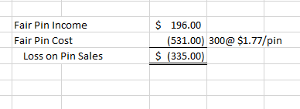
Other Financial Highlights (Continued)
We lost $335.00 on sale of fair pins (non including Regonline and credit card fees). This is an area we need to evaluate.

Slide 15
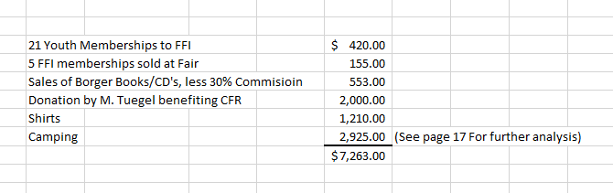
Other Financial Highlights (Continued)
During the year, WSC “passed thru” the following amounts. These transaction do not impact Profit & Loss; we simply collect cash and subsequently disburse to the appropriate party.
Note: The above amounts do not include any transaction fees which are absorbed by WSC as an expense.

Slide 16
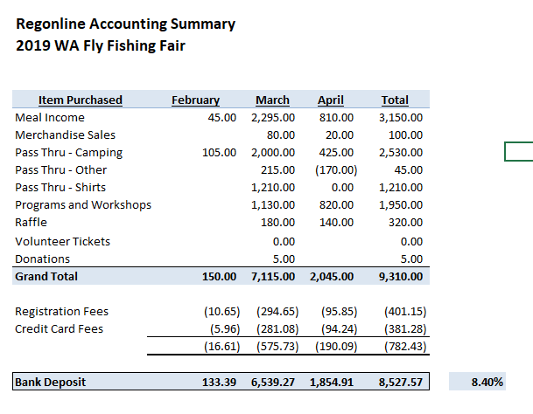
Other Financial Highlights (Continued)
Below is a summary of Regonline Activity. Gross receipts from Regonline of $9,310.00 was above prior year receipts of $8,160.00. Regonline fees (Registration and Credit Card) was 8.4% of gross sales from Regonline. Not reflected below is $375.46 in fees for use of Square POS software (about 2.75% per transaction). In total, we incurred total fee expense of $1,157.86

Slide 17
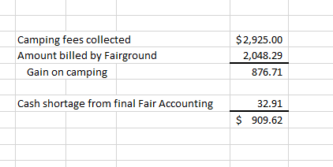
Other Financial Highlights (Continued)
Reflected in miscellaneous income of $909.62 is a $876.71 gain resulting from collecting more in camping fees than the amount invoiced by the Kittitas Valley Event Center. The Board decided to not pursue this difference due to the difficulty of reconciling.

Slide 18
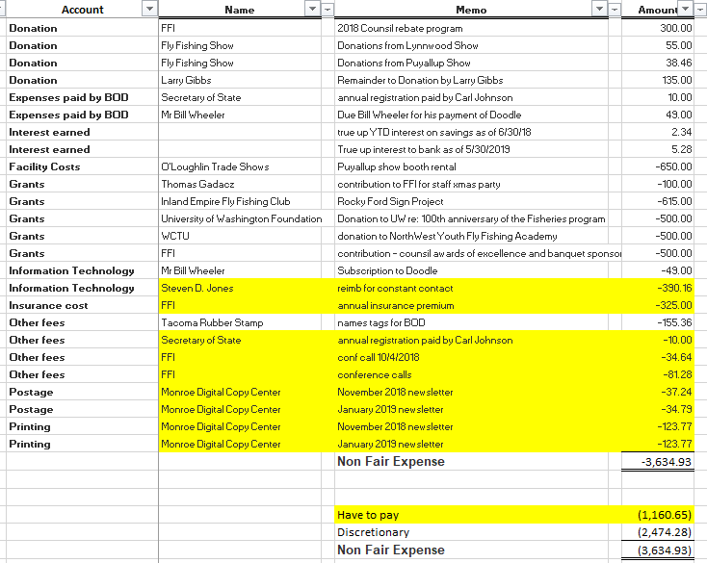
Other Financial Highlights (Continued)
Of total 2019 Non-Fair Expenses of $3,634.93, only $1,160.65 (32%) represent actual fixed expenses. Remaining expenses of $2,474.28 are discretionary.

Slide 19
Improvements Made
Accounting records converted from Quicken to QuickBooks.
  QuickBooks has more robust reporting and analysis functionality.
Balance Sheet was cleaned up to reflect correct cash balances
Converted manual banking reconciliations into QuickBooks.
Established unique pass-thru accounts to more accurately track and reconcile pass through transactions.
All deposit transaction have backup documentation.
Documented 13-page operating manual for Treasurer position.
Improved transaction descriptions to facilitate analysis and historical comparisons
Bank statements are now paperless.
  Eliminated paper copies and reduced storage.
  Check deposits are now uploaded via banking app. This eliminates trips to the bank.
Reported all Regonline and credit card transactions at gross amounts.
  Regonline and Square fees are now classified into separate accounts.
Changed fiscal reporting year from calendar year to fiscal year ending June 30th 20XX.
  This is the natural reporting cycle for our organization since annual fair expenses and income can occur in two calendar years.
  Will maintain calendar year standard for annual reporting's to FFI headquarters.
Redesigned Profit and Loss statement to separately report a Fair Margin and Non-Fair expenses, net.

Slide 20
Questions?

